Slide 1
Other Apache Spark Programming concepts

Slide 2
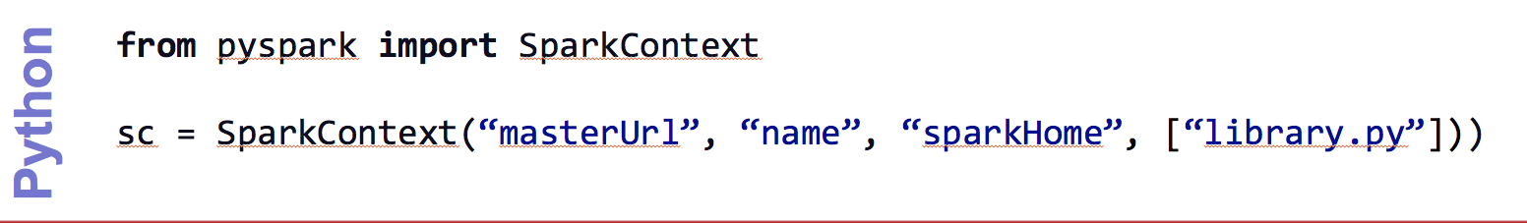
Create a SparkContext
import spark.SparkContext
import spark.SparkContext._
val sc = new SparkContext(“masterUrl”, “name”, “sparkHome”, Seq(“app.jar”))
Scala
Cluster URL, or local / local[N]
App name
Spark install path on cluster
List of JARs with app code (to ship)
import spark.api.java.JavaSparkContext;
JavaSparkContext sc = new JavaSparkContext(
“masterUrl”, “name”, “sparkHome”, new String[] {“app.jar”}));
Java

Slide 3
World Count Complete App: Python
import sys
from pyspark import SparkContext
if __name__ == "__main__":
sc = SparkContext( “local”, “WordCount”, sys.argv[0], None) lines = sc.textFile(sys.argv[1])
lines.flatMap(lambda s: s.split(“ ”)) \ .map(lambda word: (word, 1)) \ .reduceByKey(lambda x, y: x + y) \ .saveAsTextFile(sys.argv[2])

Slide 4
Word Count Complete App: Scala
import spark.SparkContext
import spark.SparkContext._
object WordCount { def main(args: Array[String]) {
val sc = new SparkContext(“local”, “WordCount”, args(0), Seq(args(1))) val lines = sc.textFile(args(2)) lines.flatMap(_.split(“ ”)) .map(word => (word, 1)) .reduceByKey(_ + _) .saveAsTextFile(args(3)) } }

Slide 5
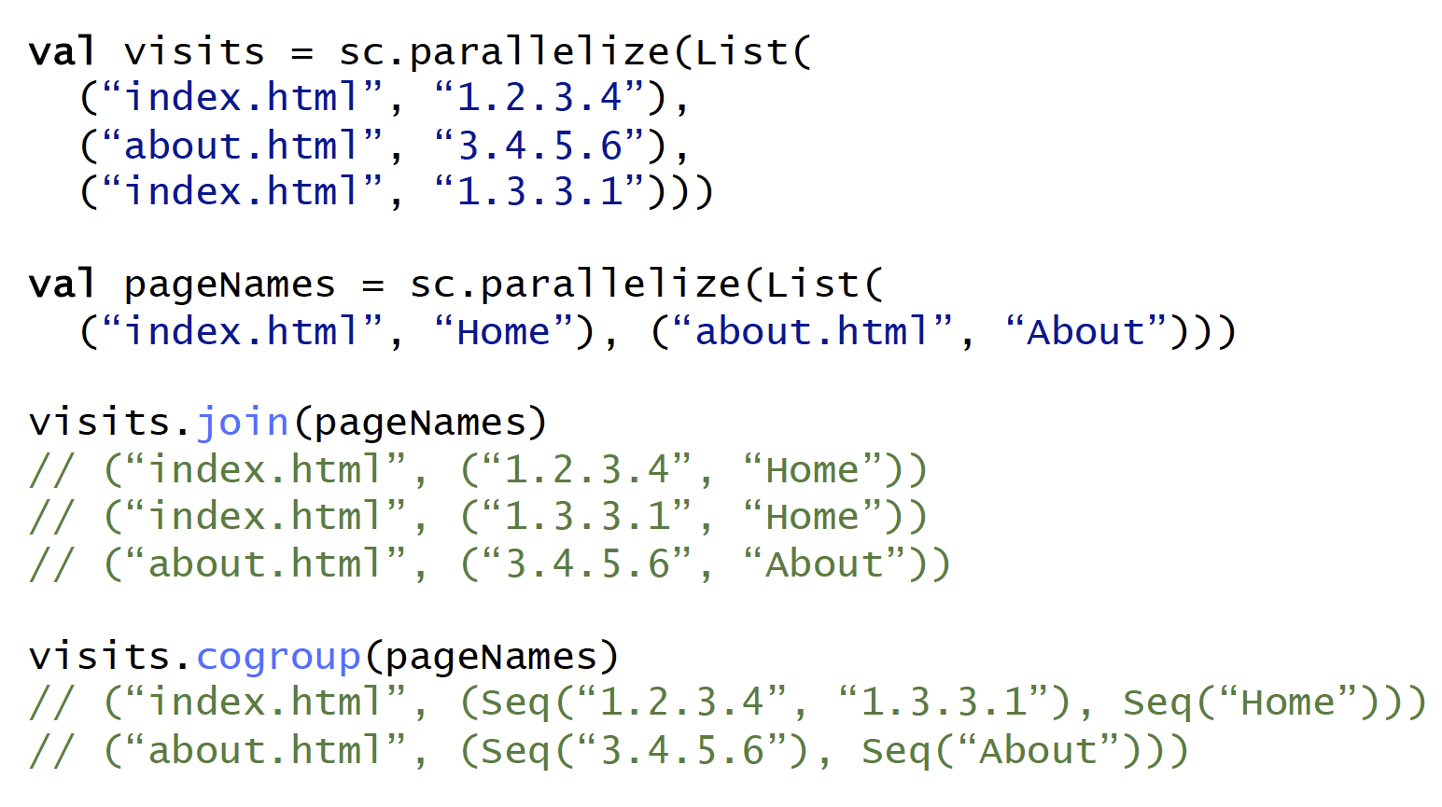
Other Key-Value Operations

Slide 6
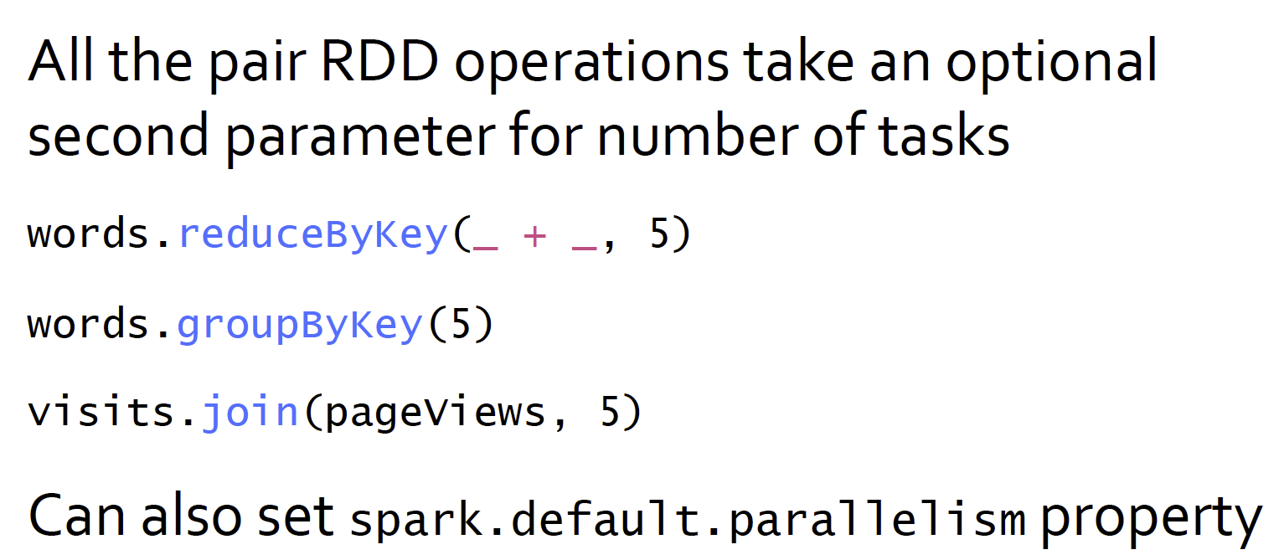
Controlling The Number of Reduce Tasks

Slide 7
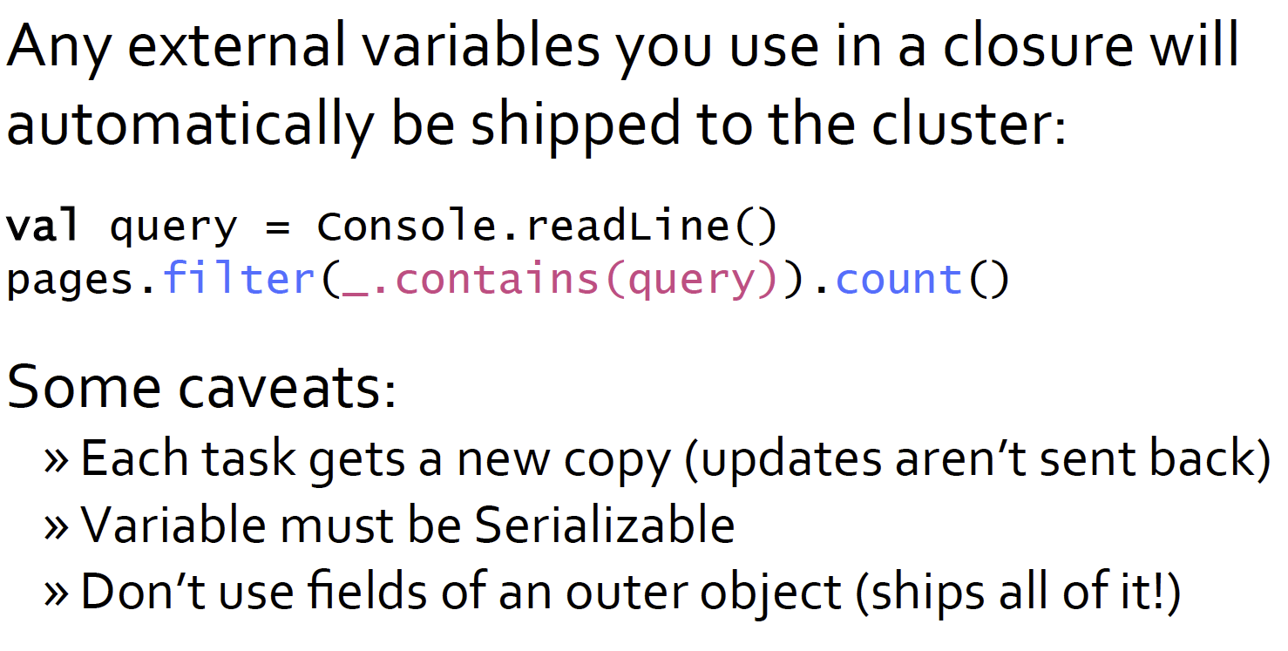
Using Local Variables

Slide 8
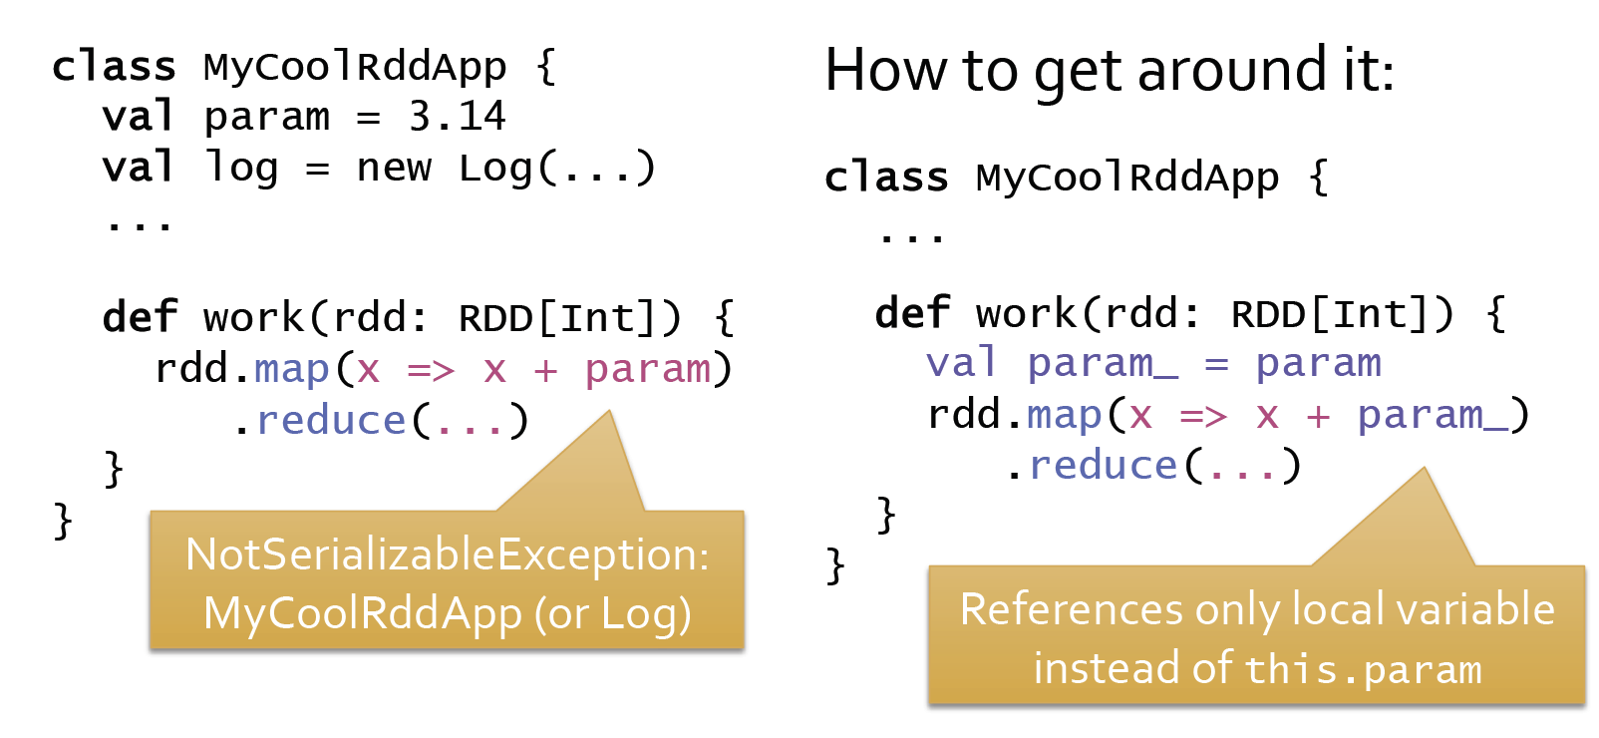
Closure Mishap Example
Even though we are just using the param member of the class MyClassRddApp, the entire object need to be serialized and shipped across the network to all the nodes.
If some part of the object is not serializable you will get an exception.

